Slide 1
Service bus

Slide 2
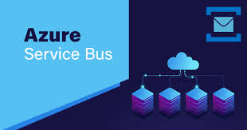
TOPICS
1.What is Azure App Service Bus?
2.Why Service Bus?
3.Service Bus Tiers With The Features
4.Service Bus Services.

Slide 3
AZURE SERVICE BUS?
Azure Service Bus is a fully managed enterprise message broker with message queues and publish-subscribe topics (in a namespace). Service Bus is used to decouple applications and services from each other, providing the following benefits:
Load-balancing work across competing workers
Safely routing and transferring data and control across service and application boundaries
Coordinating transactional work that requires a high-degree of reliability

Slide 4
WHY SERVICE BUS?
As Azure Service Bus is fully managed service, scaling and availability will be taken care by Azure team. It is integrated with other Azure services like, Event Grid, Logic Apps, Stream Analytics etc. Azure Service Bus provides reliable and secure asynchronous message communication platform along with facility of delayed processing of events or data. Shared Access Signatures (SAS), Role Based Access Control (RBAC) and Managed Service Identity (MSI) protocols are supported by it. Service Bus also supports client libraries for .NET ,Java.

Slide 5
Service Bus Tiers with Features
Standard tier
It can be used for initial development and QA environment deployments. Latency and throughput in Standard tier are variable, hence performance is not predictable. In built scaling is also not available and maximum message size is up to 256 kb.
2.Premium Tier:
It can be used for Production deployments. It provides high throughput and auto scaling for variable workloads. Maximum message size can be up to 1mb. Premium name spaces provides CPU and memory level isolation for resources. Performance of Premium tier resources at peak load is much faster than Standard ones.
Standard tier
It can be used for initial development and QA environment deployments. Latency and throughput in Standard tier are variable, hence performance is not predictable. In built scaling is also not available and maximum message size is upto 256 kb.
Premium tier
It can be used for Production deployments. It provides high throughput and auto scaling for variable workloads. Maximum message size can be up to 1mb. Premium name spaces provides CPU and memory level isolation for resources. Performance of Premium tier resources at peak load is much faster than Standard ones.

Slide 6
Service bus services:
1.QUEUES
2.TOPICS
3.RELAYS

Slide 7
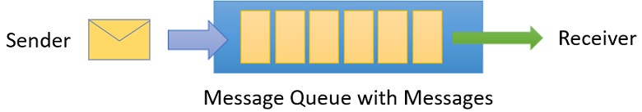
1.queues:
Queues enable us to store messages until the receiving application is available to receive and process them. Messages in queues are timestamped on arrival and ordered according to it. Messages are delivered on request (Pull mode delivery). Queue is often used for point-to-point communication.

Slide 8
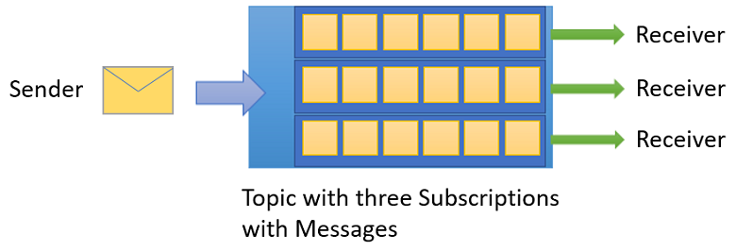
Topics:
Topics is nothing but single input queue but multiple output queues. Output queues are nothing but Subscriptions. Receiving apps needs to create subscriptions to receive messages from Topic. Subscription can filter out the messages based on rules on message properties. Publish/subscribe scenarios can be implemented using Topics.

Slide 9
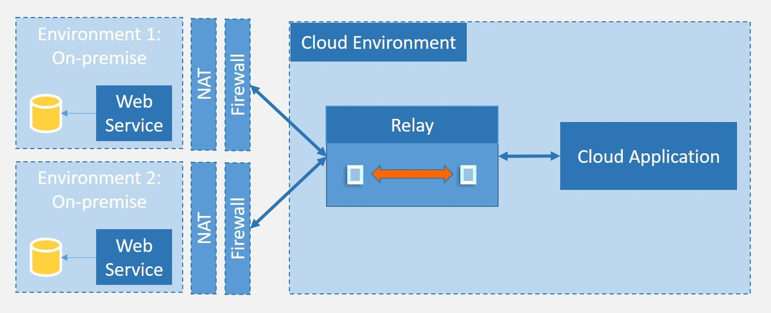
Relays:
Queues and Topics provides unidirectional messaging. To facilitate bi-directional communication, Azure provides Relay messaging service. In Queues or Topics there is no explicit connection between sender and receiver. However, for relays, each application will create outbound TCP connection to Service Bus. All communication happens using WCF (Windows communication Foundation).

Slide 10
ADVANCED FEATURES:
Message Sessions
Auto-forwarding
Dead-Lettering
Scheduled delivery
Message deferral
Transactions

Slide 11


